Slide 1
Comprehensive Diabetes
Risk Analysis
From raw data and feature engineering to clinical insight
47,541
patients analysed
50
engineered features
10
questions answered
1
Notes:
.
Now, the easy version of this talk is to tell you that fat, lazy, old people get diabetes, show you a few
charts that agree with me, and sit down. That is not this talk. Because when I actually interrogated the
data, one of my core assumptions broke in public - and that broken assumption turned out to be the most
useful thing I found.
So over the next fifteen minutes I want to take you through the full journey: how we made this data
trustworthy, who is at risk, what is happening inside the body, which behaviours drive it - and finally,
the one question everybody actually cares about: if diabetes runs in your family, are you stuck with it?

Slide 2
Five questions, in which they matter
01
02
03
04
05
Foundation
Demographics
Clinical
Lifestyle
Countermeasure
Can we trust
the data?
Who is
at risk?
What is happening
inside the body?
Which behaviours
drive it?
Can we
change it?
27.9% of rows
failed a check
+11.8 points
by age 60
87% high risk
above 140 mg/dL
A 12-point cliff,
not a slope
12 earned back
vs 9.7 inherited
The punchline: genetics set the starting line - lifestyle moves it further than genetics did.
2
Notes:
Here is the map for the next fifteen minutes, and I have deliberately ordered it as an argument rather
than a list of charts.
Part one is the unglamorous part - the data cleaning. Stay with me, because it is where I found evidence
that changes how you should read everything after it. Part two asks who is at risk. Part three goes inside
the body, to the blood markers. Part four is behaviour. And part five is the payoff.
Raws are wrong like like the male PCOS records and impossible blood pressures)
I will give you the ending now, because I would rather you spend the talk testing my argument than guessing
where it goes. Family history raises average risk by about ten points. Lifestyle moves it by twelve. The
thing you inherited is not the biggest lever in the room.
Let's start with whether any of this can be believed at all.

Slide 3
PART 1 - FOUNDATION
Before analysis, Cleaning
13,257
rows quarantined - 27.9% of the file
Missing data
Medical anomalies
Height and weight recovered mathematically from BMI; median imputation for lipids and lifestyle metrics; 156 records left null.
3,797 blood-pressure readings were physically impossible (diastolic ≥ systolic). 3,692 BMI values sat outside human range.
Every headline is calculated on the 34,284 patients that survived the quality screen - not on the raw file.
Clinical categorisation
Custom risk indices
Seven age bands, plus standardised BMI, HbA1c, fasting-sugar and blood-pressure tiers for like-for-like comparison.
Unhealthy Habits (0-7) across diet, activity and sleep; Condition Count (0-5) across hypertension, heart disease and more.
3
Notes:
Nobody claps for data cleaning. Do it badly anyway and every chart after it is fiction.
Four things happened here. We recovered missing heights and weights mathematically from BMI rather than
throwing the patients away. We flagged medical impossibilities - and this is the one I want you to
remember - nearly four thousand patients had a diastolic blood pressure equal to or higher than their
systolic. That is not a sick patient. That is a broken record. A heart cannot do that.
Third, we standardised the clinical tiers so comparisons are like for like. And fourth, we engineered two
composite indices - an Unhealthy Habits score and a Condition Count - so that behaviour and comorbidity
became things we could actually measure rather than adjectives.
The bottom line is at the left. More than a quarter of the raw file failed at least one check. Twenty-eight
percent. If you take one process lesson from today: the flags were already in this data, and the original
analysis charted straight through them.
So - with a file we can defend, let's establish the baseline.

Slide 4
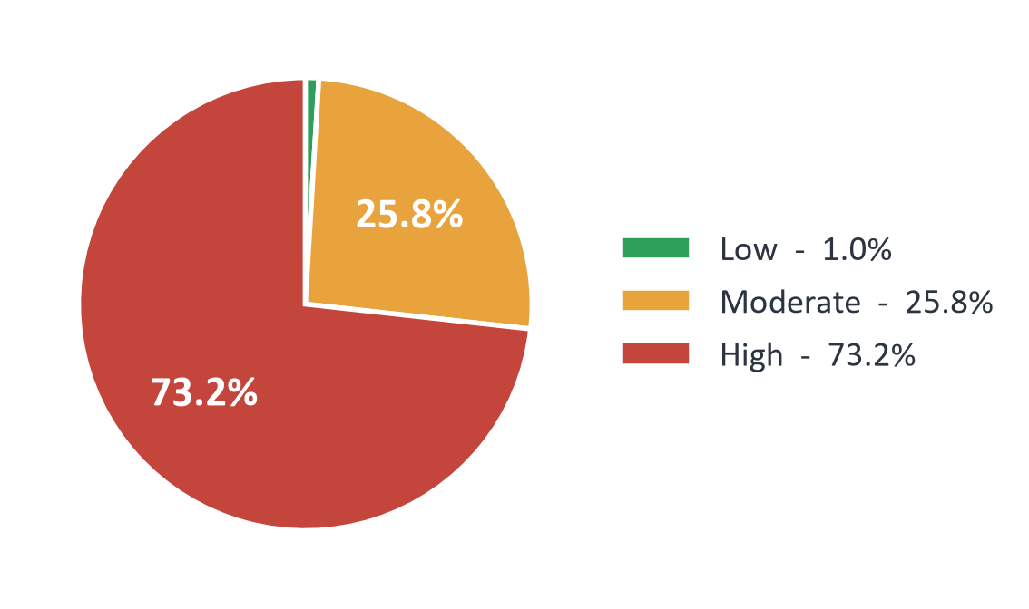
PART 1 - QUESTION 1 What is the overall distribution of diabetes risk among patients?
The baseline is already alarming
73.2%
of screened patients are already high risk
25,113 patients sit in the High band - roughly three in four.
Low risk has all but vanished: 328 people, or 1.0%.
4
Notes:
This is the room we are standing in. Seventy-three percent of screened patients are already classified
high risk. A quarter are moderate. And low risk - the group we would actually like to be in - is
essentially extinct: three hundred and twenty-eight people out of thirty-four thousand. One percent.
I want to set an expectation here that will keep us honest for the rest of the deck. When I show you later
that eighty-one percent of inactive patients are high risk, that number is only meaningful next to this
one. The baseline is seventy-three. So the real story is never "high risk exists" - it is "how far above
seventy-three does this factor push us".
With the baseline set, the first question is the obvious one. Who is carrying this risk?

Slide 5
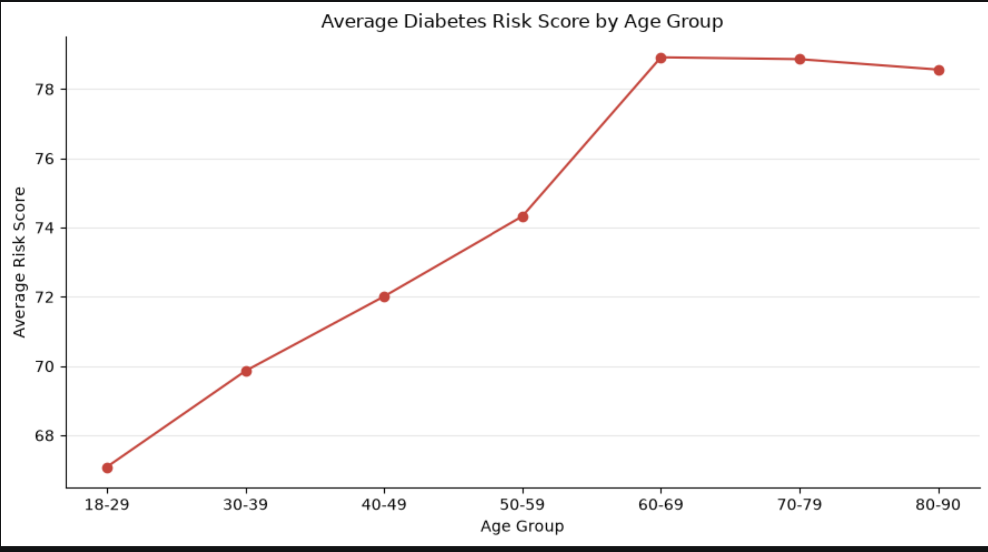
PART 2 - DEMOGRAPHICS / QUESTION 2 How does the average diabetes risk score change across age groups?
Risk climbs with age - then stops
+11
points of risk score from youngest to peak
Average score rises steadily from 67 at 18-29 to 78 at 60-69.
After 60 the curve flattens - the 70s and 80s add nothing.
The accumulation happens in mid-life, not old age.
5
Notes:
Here is where the story starts to move. Average risk score climbs with every decade of life - sixty-seven
in the late teens and twenties, seventy, seventy-two, seventy-four - and then, right around sixty, it
simply stops climbing.
Look at the shaded region. Sixty to sixty-nine, seventy to seventy-nine, eighty to ninety: seventy-eight
point nine, seventy-eight point nine, seventy-eight point six. That is a plateau, not a trend.
I think this is the most actionable slide in the demographics section, and it is easy to misread. The
instinct is to say "older patients are the problem, screen the elderly". The data says the opposite. By
sixty, the damage is already priced in. Everything that determined that score happened in the thirty years
before. If you want to intervene, you intervene in the forties and fifties, while the line is still moving.
Let me rank those same groups, because the ordering matters for where you spend money.

Slide 6
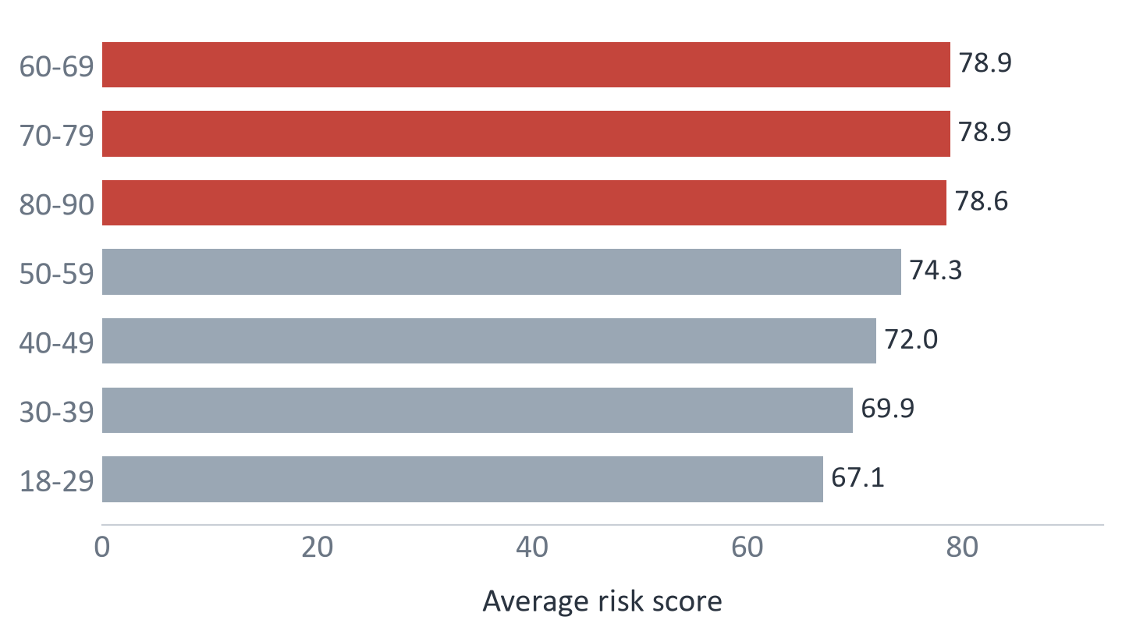
PART 2 - DEMOGRAPHICS / QUESTION3 Which age groups have higher average diabetes risk scores?
Three age bands share the top spot
78.9
average risk score across the 60+ bands
60-69, 70-79 and 80-90 are statistically indistinguishable.
18-29 sits lowest at 67.1 - but that is still above the Moderate line.
Total spread across six decades of life is under 12 points.
6
Notes:
Same numbers, ranked, because ranking is how budget decisions actually get made.
The three highlighted bars are the top three, and they are effectively tied - the difference between them
is a rounding error. So if someone asks you "which age group should we target", the honest answer is that
the sixty-plus population is one single group, not three.
But notice the bottom bar. Even our healthiest cohort, the eighteen to twenty-nine year olds, averages
sixty-seven. In a population this skewed, being young buys you less than you would hope - and the entire
spread across six decades of human life is under twelve points.
That tells me age is real, but age is not the main event. So let's stop asking who, and start asking what.
What is actually happening inside these patients?

Slide 7
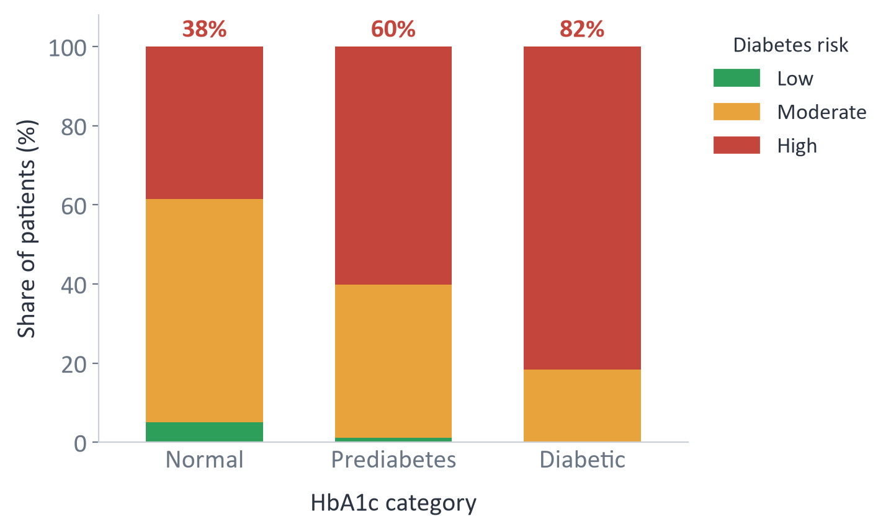
PART 3 - CLINICAL DIAGNOSTICS / QUESTION 4 How does diabetes risk vary across different HbA1c categories?
HbA1c is the sharpest divider we have
2.1x
more high-risk patients in the diabetic tier vs normal
High-risk share: 38% Normal, 60% Prediabetes, 82% Diabetic.
Each clinical tier adds roughly twenty points of risk.
.
7
Notes:
Now we are inside the body, and this is the cleanest signal in the entire analysis.
HbA1c (Hemoglobin A1c) is a blood test that measures your average blood sugar (glucose) levels
Read the three red numbers across the top. In patients with normal HbA1c, thirty-eight percent are high
risk. Move to prediabetic, sixty percent. Move to diabetic, eighty-two. Each clinical step adds about
twenty points, and the gradient never flattens.
Two things worth saying out loud. First, this is exactly what we should see - HbA1c is your three-month
blood sugar average, so if it did not track risk I would question the risk score, not the medicine.
Second, and more interesting: look at the leftmost bar again. Thirty-eight percent of patients with
perfectly normal HbA1c are still classified high risk. A normal blood test is not an all-clear. Something
else is loading those patients up.
Hold that thought, because the next chart is the usual suspect.

Slide 8
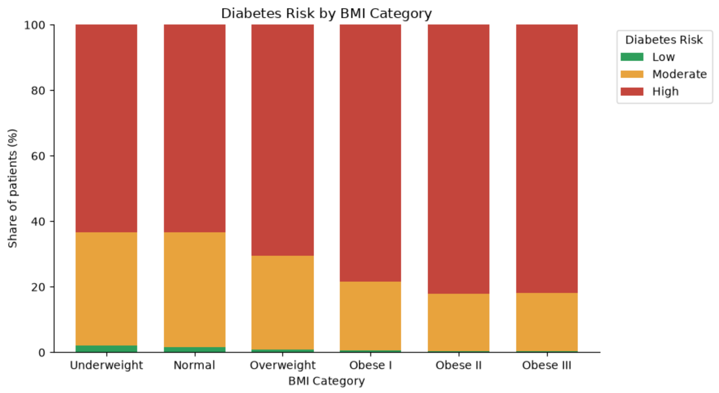
PART 3 - CLINICAL DIAGNOSTICS / QUESTION 5 - How does diabetes risk vary across different BMI categories?
Weight moves the needle - up to a point
+18.8
point jump in high-risk share, Normal to Obese II
High-risk share climbs from Normal to 80% at Obese II.
Obese II and Obese III are level - the curve saturates.
Underweight tracks Normal.
8
Notes:
And the usual suspect delivers. Sixty-three percent high risk at a normal BMI, seventy percent overweight,
seventy-eight at Obese class one, eighty-two at class two.
Two details that reward a closer look. First, the curve saturates - Obese class three is no worse than
class two. Past a certain point, more weight stops adding measurable risk in this data, probably because
those patients are already at the ceiling. Second, the underweight bar sits level with normal, which is
reassuring: it tells us we are measuring excess weight, not general frailty.
So far, so predictable. Age matters, blood sugar matters, weight matters
And then I ran the next chart, and it broke.

Slide 9
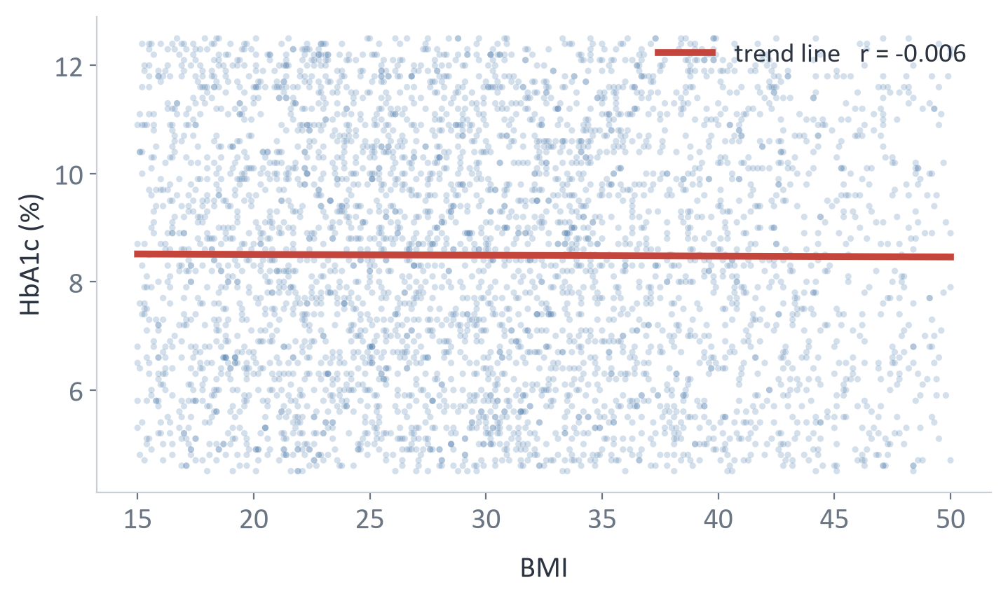
PART 3 - CLINICAL DIAGNOSTICS / QUESTION 6Is there a relationship between BMI and HbA1c levels?
The assumption that did not survive
r = -0.006
correlation between BMI and HbA1c
We expected a clear upward slope. The trend line is flat.
Knowing a patient's BMI tells you nothing about their HbA1c here.
Clinically these should correlate.
9
Notes:
This is the slide I was most tempted to delete, and the one you should remember.
Going in, I expected a clear upward drift - heavier patients carrying higher blood sugar. It is in every
textbook. What came back was a wall of noise and a trend line so flat you could use it as a spirit level.
The correlation is minus nought point nought nought six. That is not a weak relationship. That is no
relationship at all.
Now, I could have cropped the axes, or sampled a convenient subset, and made this look like a gentle
slope. Plenty of decks do. I would rather show you the flat line and tell you what it means, which is
this: in real patient populations BMI and HbA1c do correlate, so when they are perfectly independent, the
most likely explanation is that these two columns were generated independently. This dataset behaves
synthetically.
That does not invalidate the work - the relationships I have shown you are real properties of this file,
and the method transfers directly to clinical data. But it does change the verb. We are not discovering
medicine today. We are demonstrating a pipeline, and being straight about its limits.
With that caveat on the table, let's see which markers actually do the work.

Slide 10
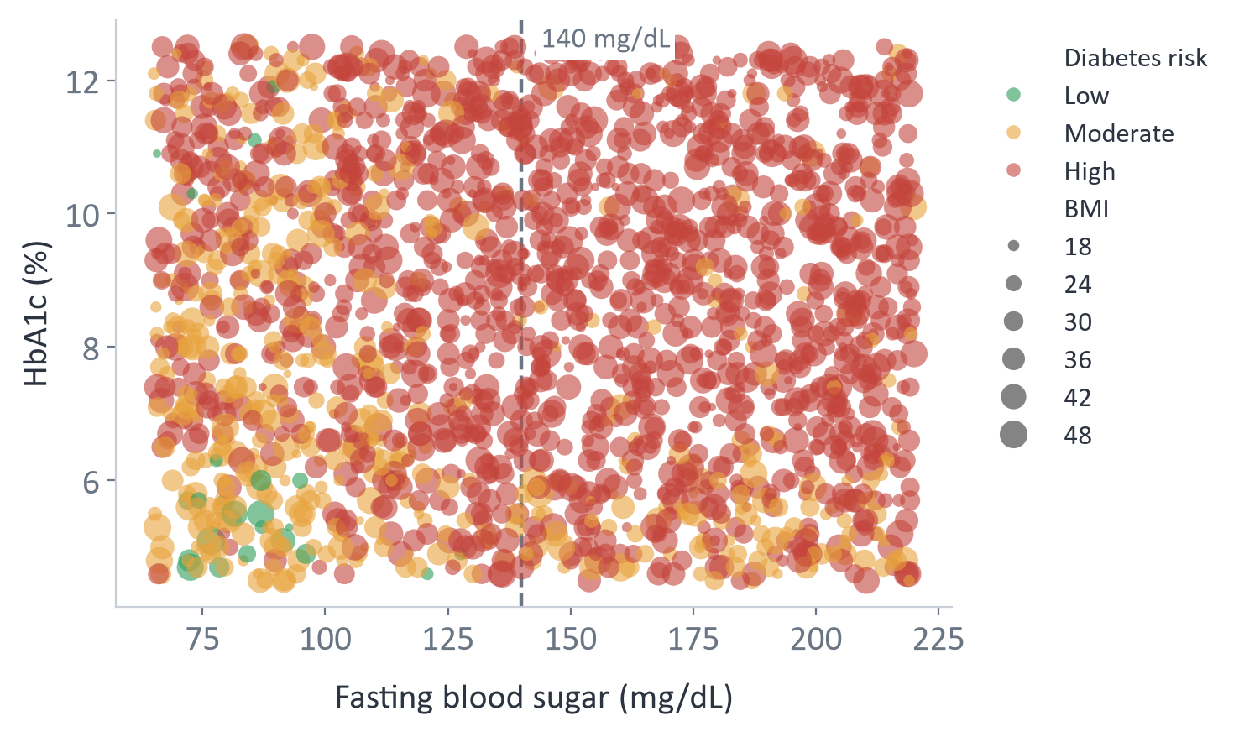
PART 3 - CLINICAL DIAGNOSTICS / QUESTION 7 How do combined diagnostic markers and BMI correlate with overall Diabetes Risk?
Mapping the danger zone
87.3%
high risk above 140 mg/dL fasting blood sugar ( high risk count / total zone )
Below 100 mg/dL that share falls .
Ranked by strength: fasting blood sugar , HbA1c , BMI .
10
Notes:
This is four dimensions on one canvas: fasting blood sugar across, HbA1c up, bubble size is BMI, colour is
risk. And the danger zone draws itself. ercentage = (high_risk_count / total_in_zone) * 100
No from crosstab
Look at the right-hand side. Above a hundred and forty milligrams per decilitre, eighty-seven percent of
patients are high risk. Below a hundred, that drops to thirty-nine. That single threshold is the most
decisive cut anywhere in this analysis.
Now rank the markers by how strongly each tracks the risk score. Fasting sugar, nought point four five.
HbA1c, nought point three two. BMI, nought point two three. Fasting glucose is doing roughly twice the
work of BMI.
And notice what the bubbles are telling you - or rather, not telling you. Big bubbles and small bubbles
are scattered evenly across the whole plot. I had expected the large ones to cluster in the top right and
confirm a compounding effect. They do not. BMI is a separate, weaker channel, exactly as the flat line on
the last slide warned us.
The practical read: if you can afford one test, make it fasting glucose.
So much for what is inside the body. What about what people actually do?

Slide 11
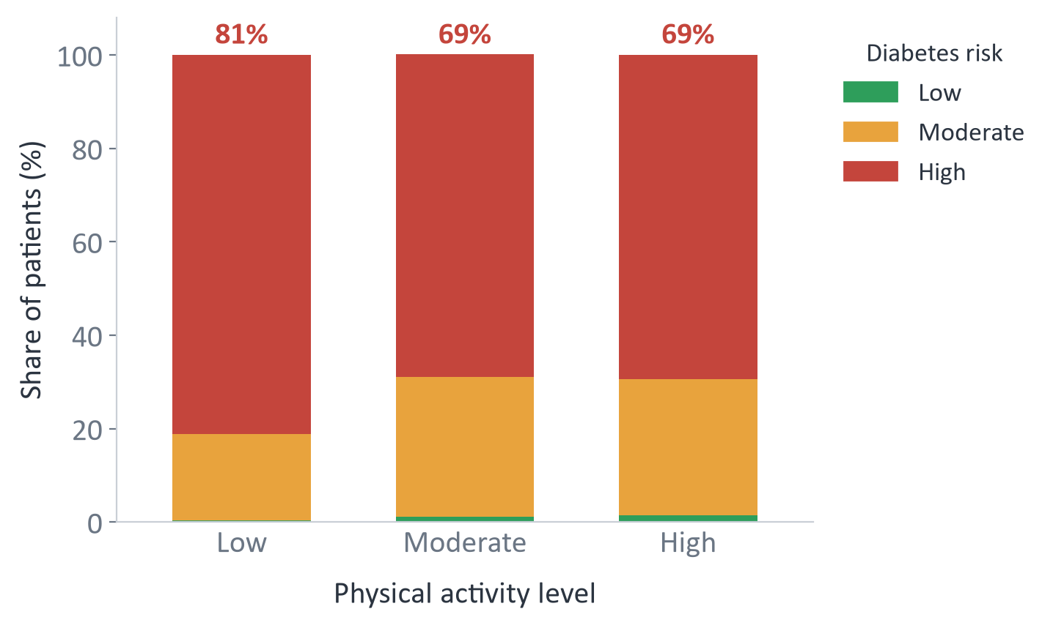
PART 4 - LIFESTYLE / QUESTION 8How does diabetes risk vary across different physical activity levels?
Daily Behaviors impacts
81.%
of low-activity patients are high risk
Moderate activity: 69% high risk. High activity: 69%.
Moving at all buys the full benefit .
The 12-point penalty falls entirely on the inactive group.
11
Notes:
Part four. Behaviour.
Eighty-one percent of the least active patients are high risk, against a baseline of seventy-three. That
is the expected headline, and it holds.
But the interesting number is the one nobody puts on a poster. Compare moderate activity at sixty-nine
point one with high activity at sixty-nine point four. They are identical. Within rounding, the marathon
runners in this dataset are no better off than the people going for a decent walk.
This is not a slope where more is always better. It is a cliff, and the entire twelve-point penalty falls
on one group - the people doing nothing at all. That should completely change how you write the health
message. "Exercise more" asks everyone to climb. "Do something" asks one group to step back from an edge,
and it is the only message this data supports.
Now watch what happens when I run exactly the same analysis on diet.

Slide 12
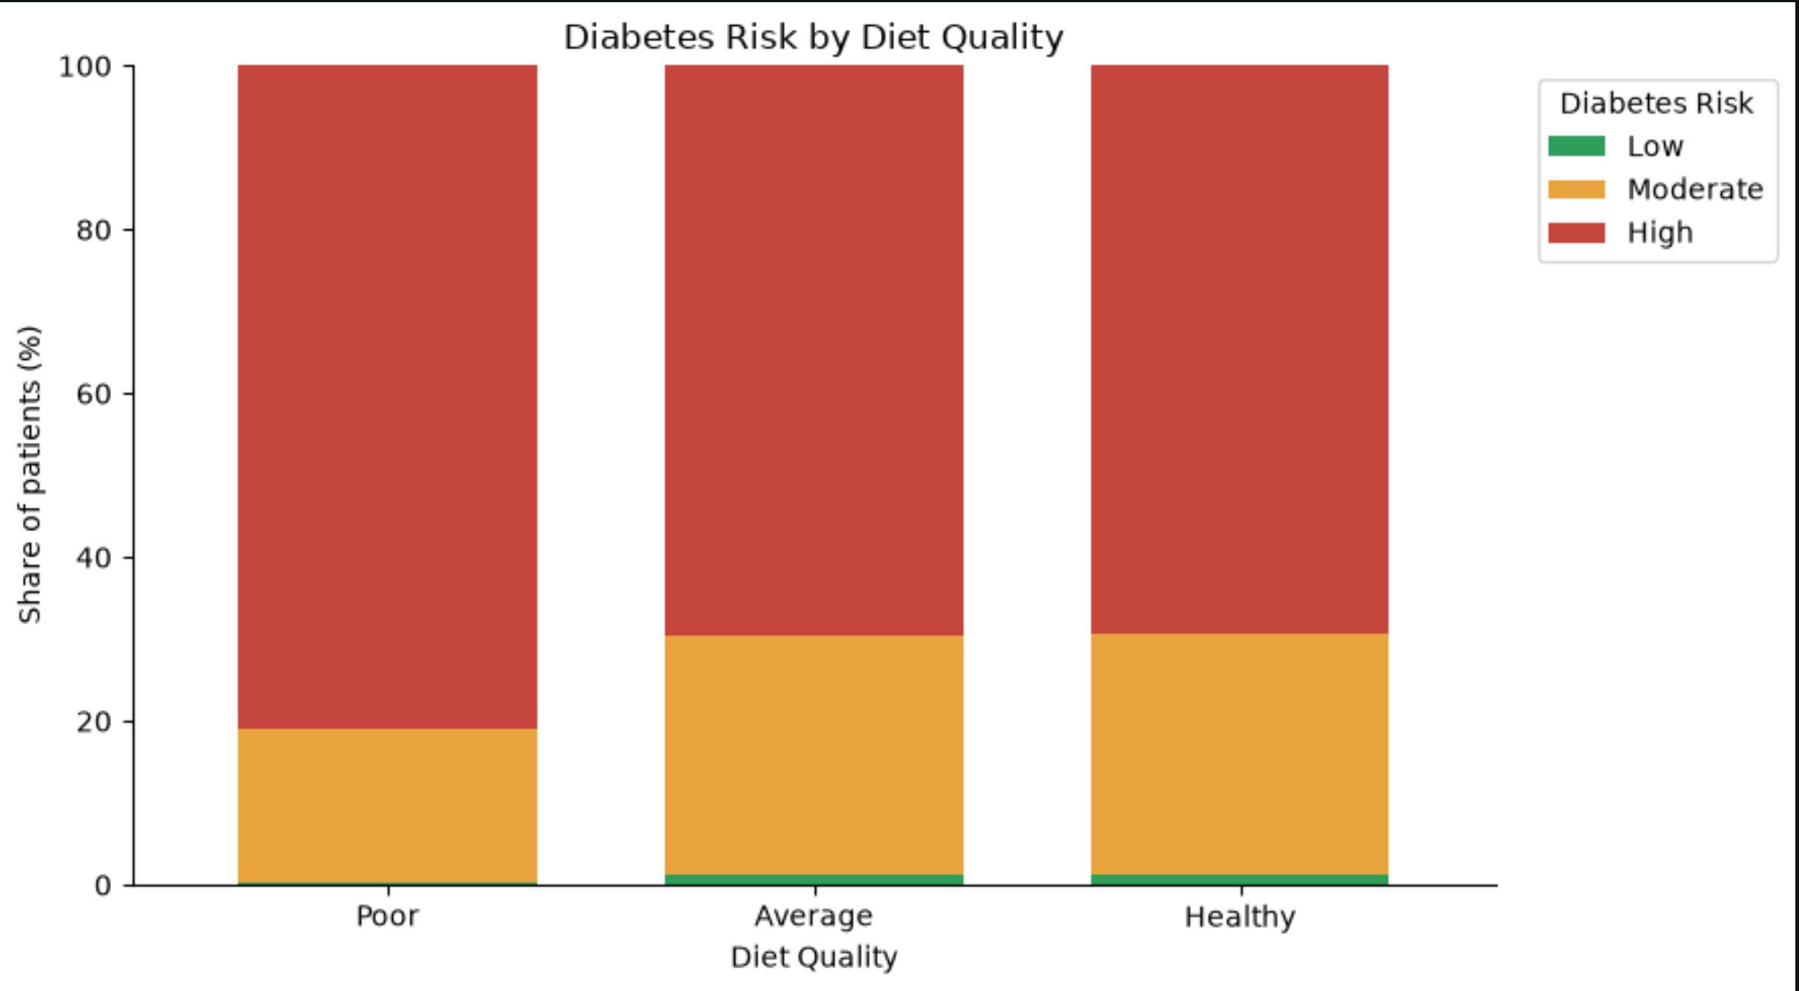
PART 4 - LIFESTYLE / QUESTION 9How does diabetes risk vary across different diet-quality levels?
Diet tells the same story, twice
80%
of poor-diet patients are high risk
Average diet: 70%. Healthy diet: 70%.
Two independent behaviours, one identical shape.
12
Notes:
Same chart, different behaviour, and look at the shape. Poor diet, eighty-one percent high risk. Average
diet, sixty-nine point five. Healthy diet, sixty-nine point four.
It is the cliff again. Two entirely independent behaviours - what you eat and whether you move - and both
produce the identical pattern: one bad category carrying a twelve-point penalty, and then nothing.
When two independent variables produce the same shape that precisely, I take it seriously as a finding. It
says the public-health return is concentrated at the bottom of the distribution. Moving one person out of
"poor diet" into merely "average" captures the entire available benefit. Moving someone from average to
immaculate captures none of it.
That reframes the goal from perfection to floor-raising - and it makes the intervention dramatically
cheaper.
Which brings us to the question underneath all of this. The one patients actually ask.

Slide 13
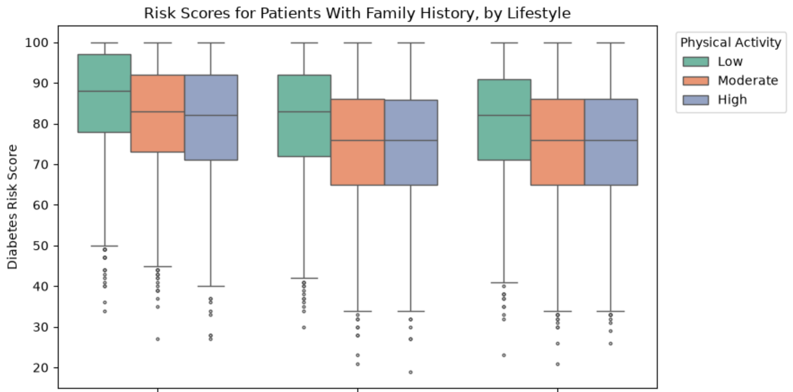
PART 5 - THE COUNTERMEASURE / QUESTION 10 Can modifiable lifestyle factors offset the risk for patients with a family history of diabetes?
Genetics load the gun. Lifestyle pulls it back.
12 pts
median spread from worst to best lifestyle
Family history costs 9.7 points on average: 78.9 vs 69.2.
Within that group, lifestyle spans 88 down to 76 - a 12-point swing.
Lifestyle moves risk further than the inherited penalty itself.
13
Notes:
Box plot :
78.9 vs 69.2 (The 9.7 point penalty): This was calculated by looking at the entire dataset and finding the average (mean) Diabetes_Risk_Score based on the Family_History_Diabetes column.
Average score for patients without family history = 69.2
Average score for patients with family history = 78.9
The difference (78.9 - 69.2) is 9.7 points. This establishes the baseline genetic penalty.
88 (The worst lifestyle score): To build the boxplot, the data was filtered to only include patients with a family history. Then, the code found the median risk score for the group with the worst habits (e.g., "Poor" Diet Quality and "Low" Physical Activity). If you look closely at the highest green box on the chart, the horizontal line in the middle of it sits exactly at 88.
76 (The best lifestyle score): Still looking only at patients with a family history, the code found the median risk score for the group with the best habits (e.g., "Good" Diet Quality and "High" Physical Activity). If you look at the lowest blue box on the chart, the horizontal line in the middle of it sits exactly at 76.
12 pts (The median spread): This is simply the mathematical difference between the worst lifestyle group and the best lifestyle group within the family history cohort (88 - 76 = 12).

Slide 14
PART 5 - THE COUNTERMEASURE
Three decisions this data supports
01
02
03
Screen on fasting glucose first
Intervene in your 40-59
Exercise and regulated diet
It separates risk groups roughly twice as strongly as BMI. If the budget covers one test per patient, this is the one that earns its cost.
Risk accumulates through mid-life and plateaus at 60. Screening programmes aimed at the elderly arrive after the score is already set.
Average and healthy behaviour score identically. The entire measurable benefit sits in moving people out of the poor category.
All three are cheaper than the programmes they replace.
14
Notes:
So what do we actually do on Monday morning? Three decisions, and each one comes straight off a chart you
have already seen.
One: screen on fasting glucose. It tracks risk about twice as strongly as BMI does, and it is a cheaper
test than the panel most programmes run by default.
Two: move the screening window earlier. Forty to fifty-nine, while the line is still climbing. Every
programme I have seen targets the over-sixties, and by then the score has already plateaued. We are
measuring the damage instead of preventing it.
Three, and this is the one that will get pushback: stop optimising for perfect behaviour. Average and
healthy score identically in this data. All of the benefit is in the first step off the bottom. That means
the intervention is not a gym membership and a nutritionist - it is getting someone to walk and eat
something reasonable. It costs a fraction as much and captures the same twelve points.
Before I close, I owe you the limitations.

Slide 15
CLOSING
“Genetics load the gun.
Lifestyle pulls it back.”
9.7 points inherited.
12 points earned back.
Thank you - questions welcome, especially the awkward ones.
15
Notes:
Four honest caveats, and I would rather you hear them from me than find them yourselves.
One: BMI and HbA1c are uncorrelated in this file. In living patients they are not. That is the strongest
evidence that this data was generated rather than collected, and it caps how far the clinical conclusions
travel.
Two: the risk score is itself an engineered feature. Some of the relationships I showed you are partly
true by construction rather than by discovery, and any competent reviewer will ask about that. The
lifestyle and family-history findings are the ones I would defend hardest, because they involve
comparisons the score does not trivially determine.
Three: twenty-eight percent of rows failed a quality check - and those flags were already sitting in the
file, being charted straight through. That is a process finding as much as a data one.
Four: the fix. The pipeline - the cleaning rules, the engineered indices, the question structure - moves
to a real clinical dataset unchanged. The conclusions have to be re-earned there, and they should be.
But the shape of the finding is what I keep coming back to. Ten points of inherited risk. Twelve points
you can act on. Whatever the dataset, that is the argument worth testing next.
Thank you. I am happy to take questions - particularly the awkward ones.

